Slide 2
Sales Rep Training Skilled Nurse Facility Hospital & Agencies

Slide 3
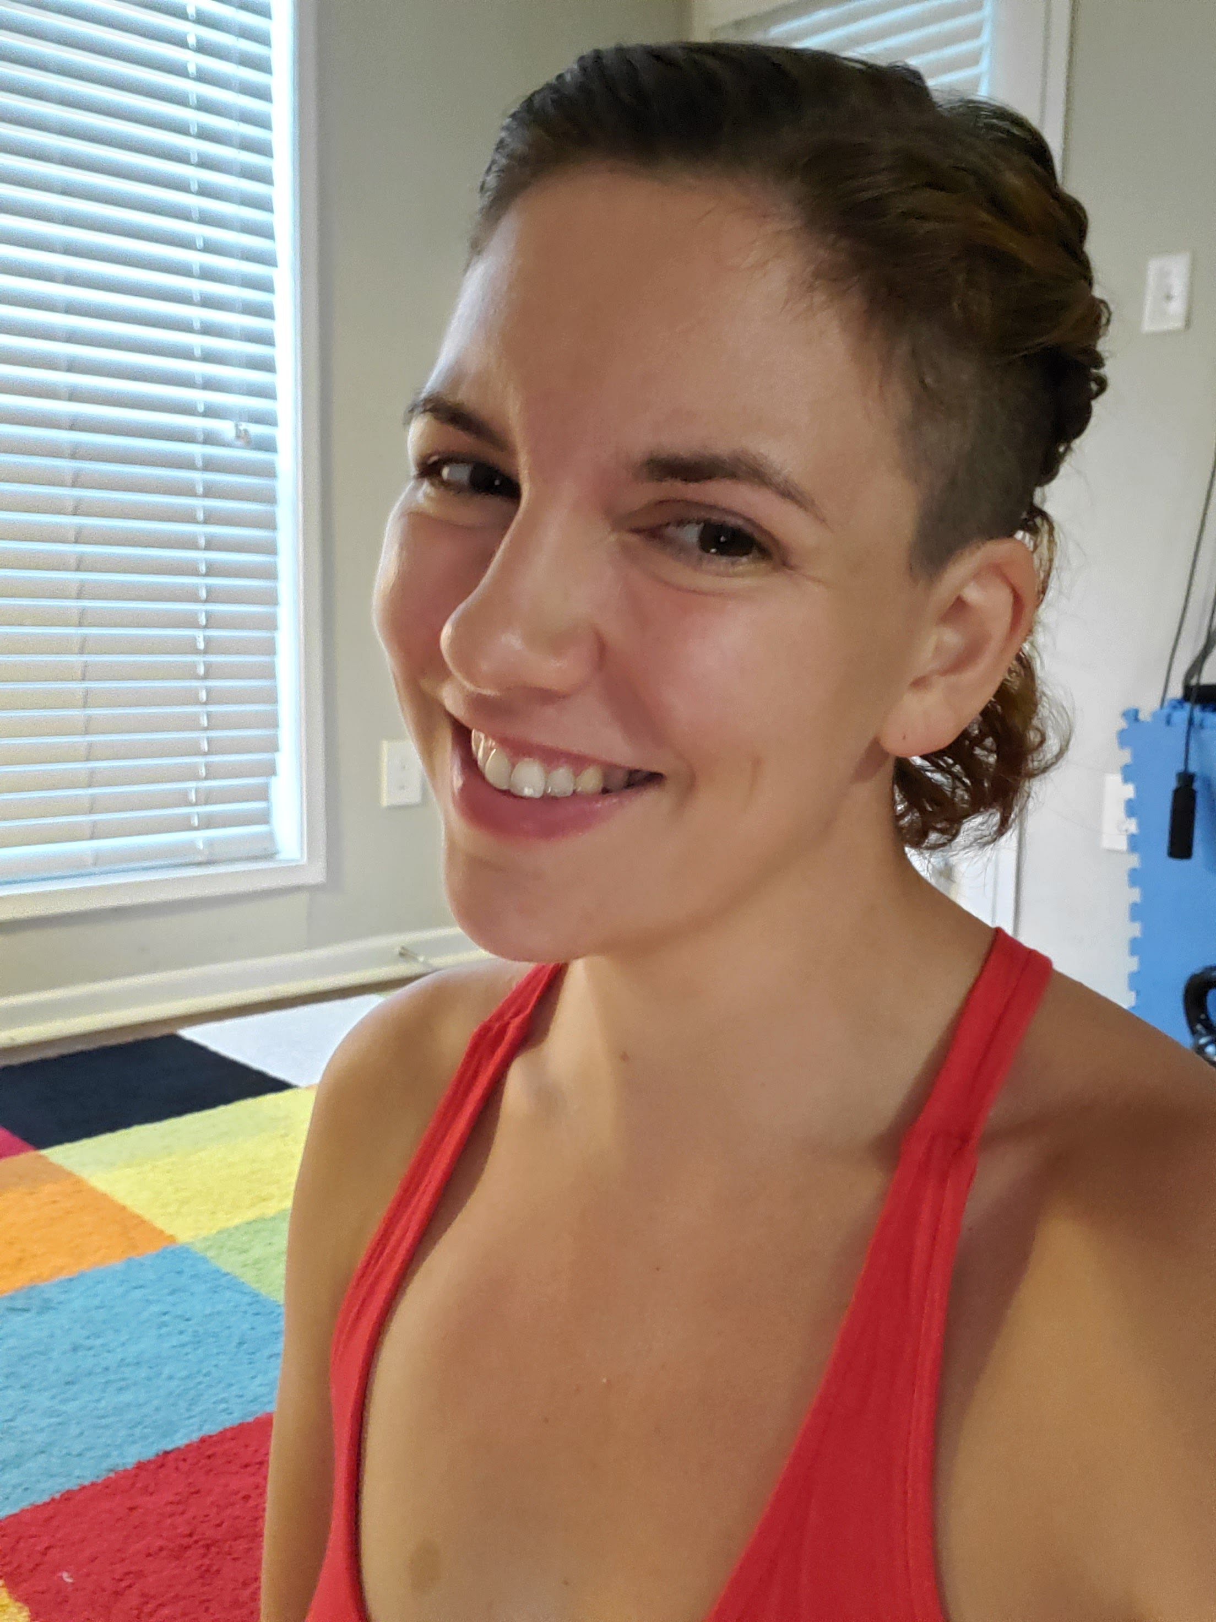
Meet the Trainer
Kate Work
Sr. Consultant
kwork@trellahealth.com
Training
Consulting
Teresa Buglione Director of Services
tbuglione@trellahealth.com
TRAINING
CONSULTING
AD-HOC Reports

Slide 4
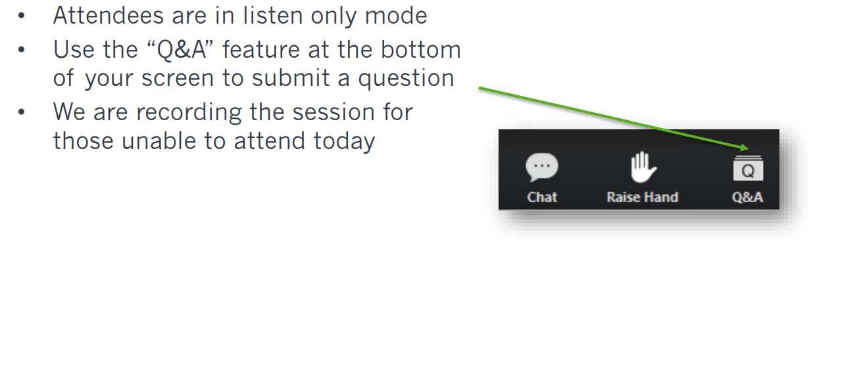
Housekeeping

Slide 5
In this Training
Follow a simpler workflow.
Understand how to use Discharge Events by Setting
Understand the Outcomes by setting
Review Patient Diagnostic Mix, MS- DRG & Readmit Groupings Tables
Understand how to use Patients Discharged with SNF Instruction
Review how to use Destinations Table.
See a preview of Hospital Sales Spotlight

Slide 6
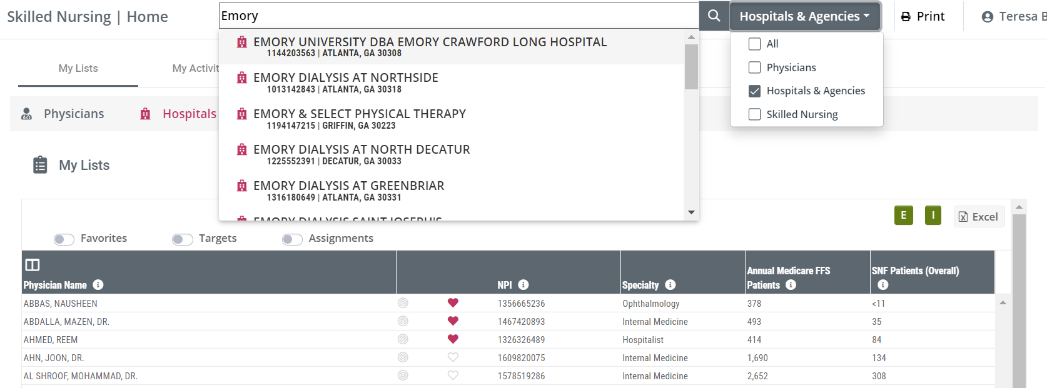
Home: Basic Functions
Global Search
Globe
Notes:
Global Search: with the global search bar, you can search for any provider by Name, NPI, or Alias from anywhere within the product and navigate directly to that provider’s Analyze page.

Slide 7
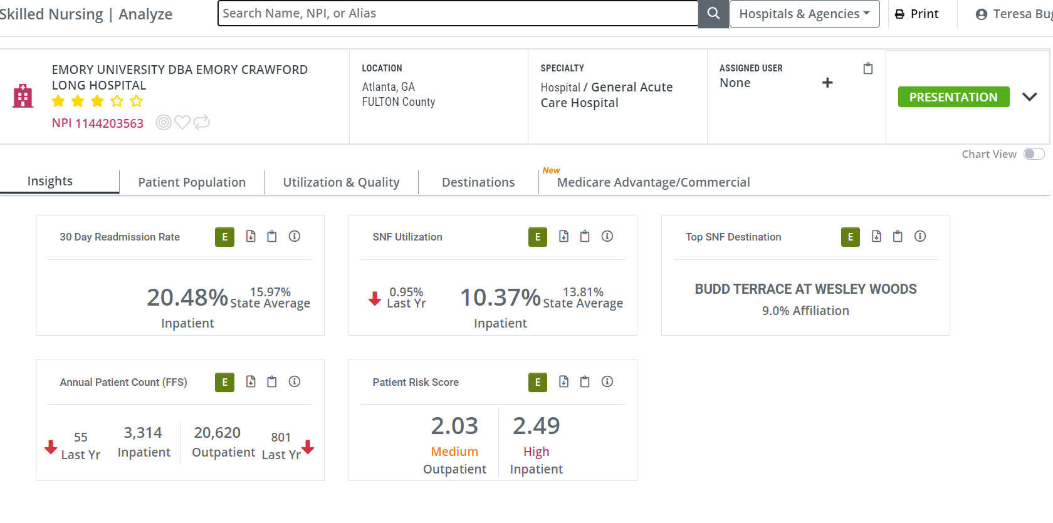
Analyze Page
Notes:
The Hospital Analyze page contains metrics that provide insights into your selected Hospital/facility.

Slide 8
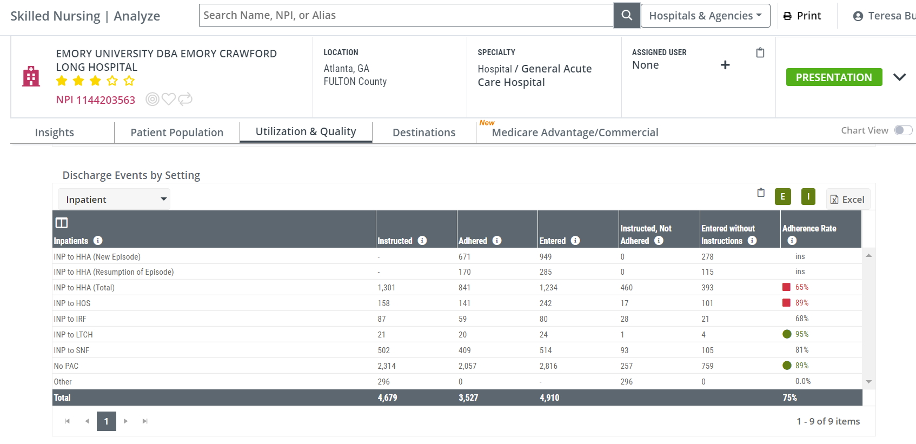
Utilization & Quality: Discharge Events by Setting
Notes:
Patient flow - This table shows the flow of discharges from a specific setting within a facility to a spread of post-acute care options. The specific setting is found in the table name; so, for the table shown below, we are counting discharges from inpatient care.
Discharges Instructed - This is the count of discharges coded for the type of post-acute care listed in each row. A discharge will have a single status.
Discharges who Adhered - This count is a subset of the Instructed column. Every discharge will either be admitted to the coded post-acute care or not. The Adhered count is the number of patients who were admitted to the post-acute setting indicated in the status coding at discharge.
Discharges who Entered - This is the count of all discharges who were admitted to the post-acute setting in each row.
Opportunities - The two columns, Instructed, not Adhered, and Entered without Instructions include the metrics that are the highlight of this table.

Slide 9
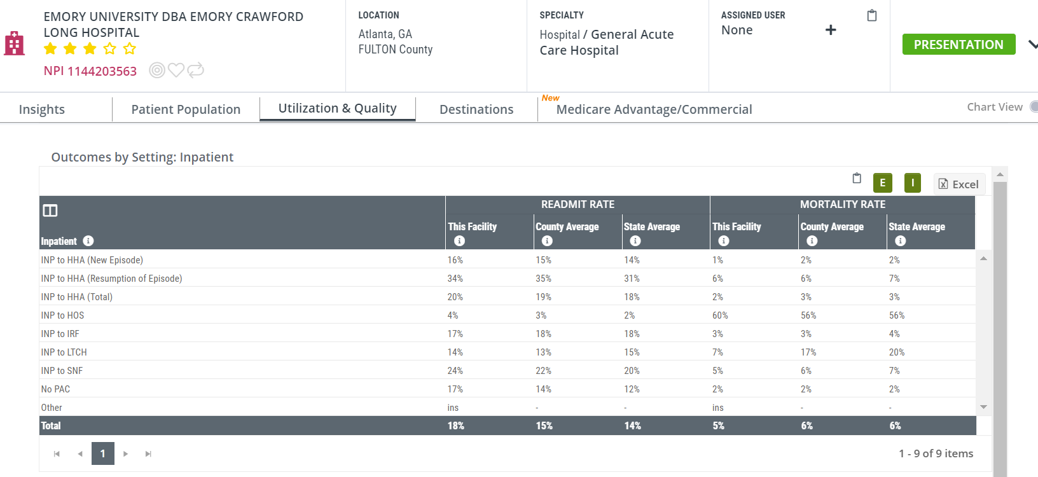
Utilization & Quality: Outcomes by Setting
Notes:
This table is the flip side of the table Discharge Events by Setting. That table answers the question, "After discharge, where'd everybody go?" This table answers the question, "What happened when they got there?"
This action-packed table provides several insights into the post-acute care provided to patients discharged from the selected facility. Readmission rates and mortality rates are calculated for several different post-acute destinations with county and state averages available as benchmarks for comparison.

Slide 10
Utilization & Quality: Patients Discharged with SNF Instruction
Notes:
This table shows the impact of home health care on the patients discharged from the selected facility who were coded for SNF care. For these patient discharged , we compare metrics for three possible outcomes:
1 - Patients admitted to a SNF
3 - Patients who were not admitted to a SNF - this could mean they were admitted to another post-acute setting or just went home.

Slide 11
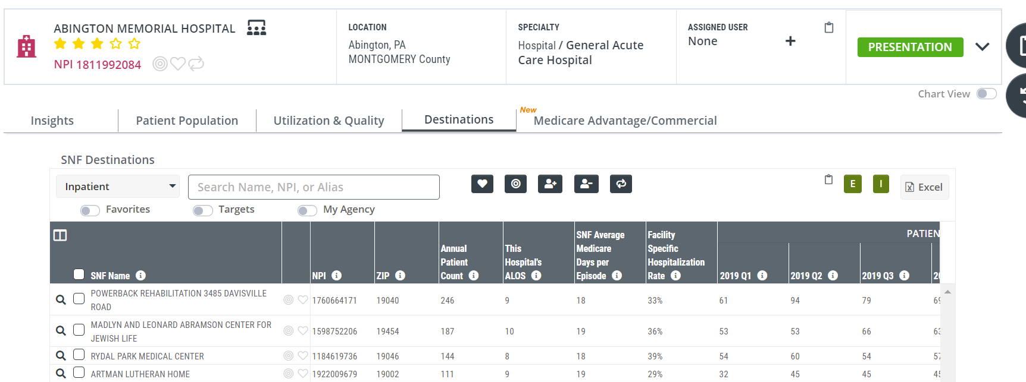
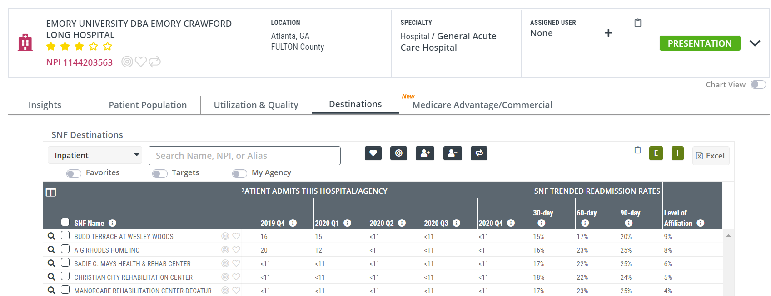
Destinations Table
Notes:
The SNF Destinations table on the Facility Analyze page includes a list of every SNF that admitted patients treated by the
selected facility. This table shows you the aggregated counts of distinct patients as they moved through the continuum of care from the selected facility to the home health agencies that subsequently admitted them.

Slide 12
Skilled Nurse Facility

Slide 13
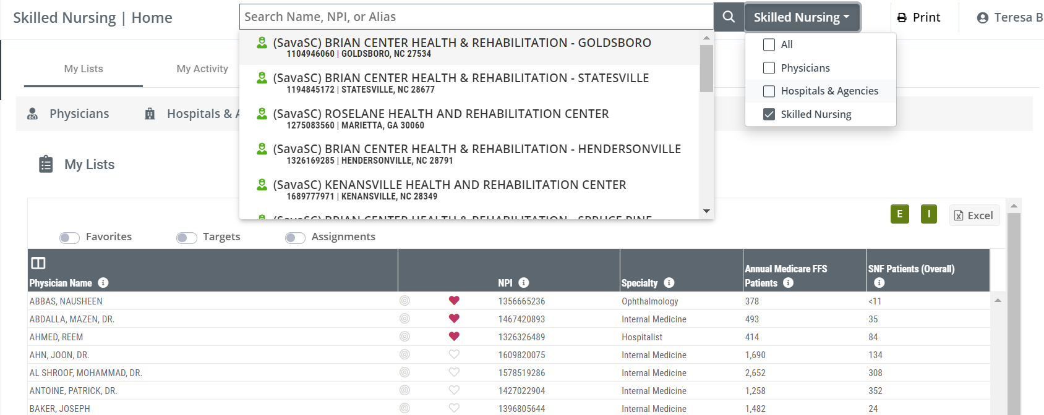
Skilled Nurse Facility
Global Search
Notes:
If you are new to the facility, or your territory is new to you, you can go to Home Page look up your facility and go to the Analyze Page. Use the sources tab to view who are the hospitals that have the highest market share with your Facility.

Slide 14
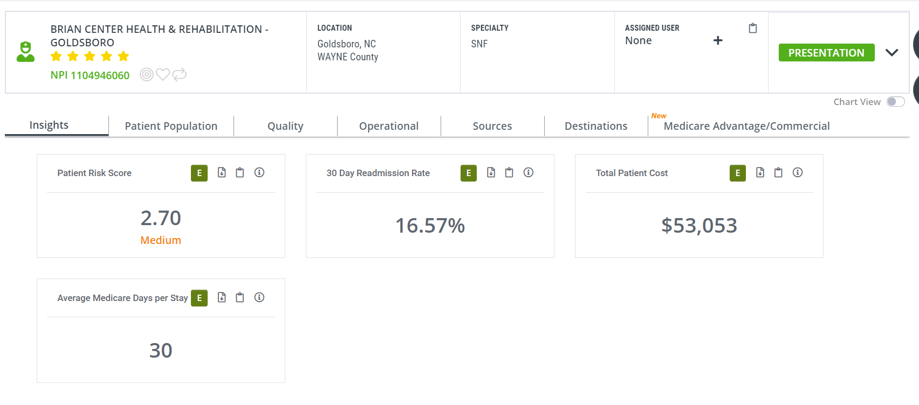
Sources: SNF Sources

Slide 15
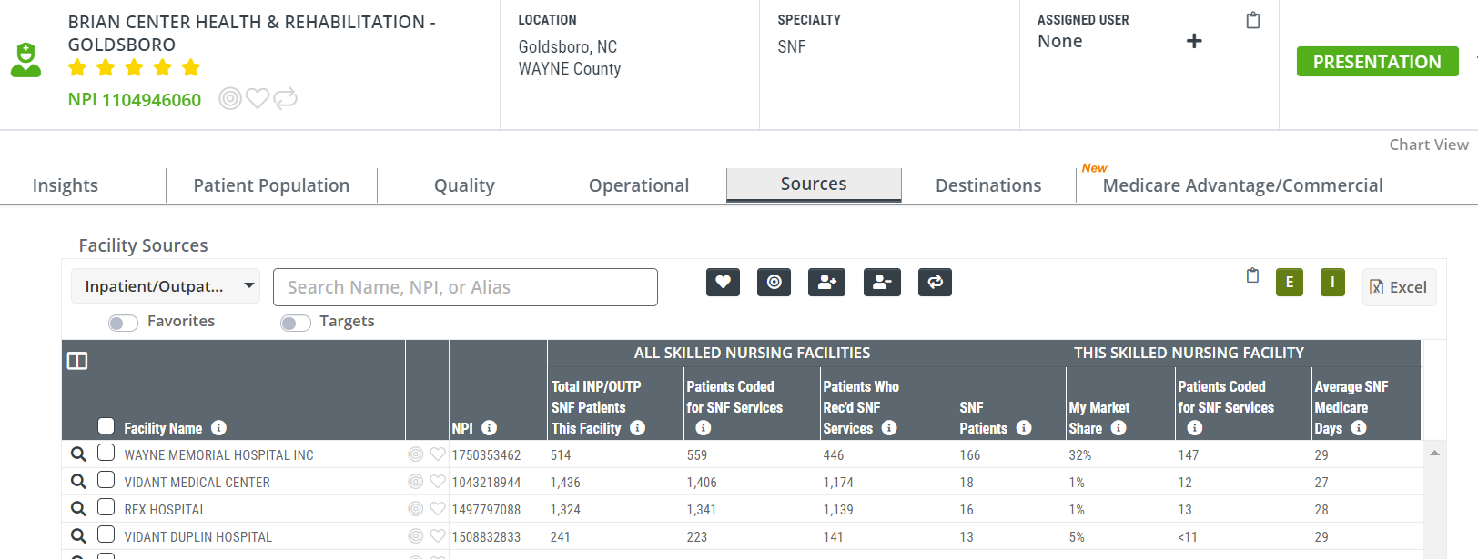
Sources

Slide 16
Activity
Top 3 Facilities/Hospitals
Global Search from Home Page
Utilization & Quality Tab
Discharge Events By setting
Outcomes By setting
Patients Discharged with SNF Instruction
Destinations Table
Review
Any surprises in the data that you viewed?
Are you the preferred provider?
Are you in the top 5 destinations?
How can this information help you strengthen your partnership with this provider?

Slide 17
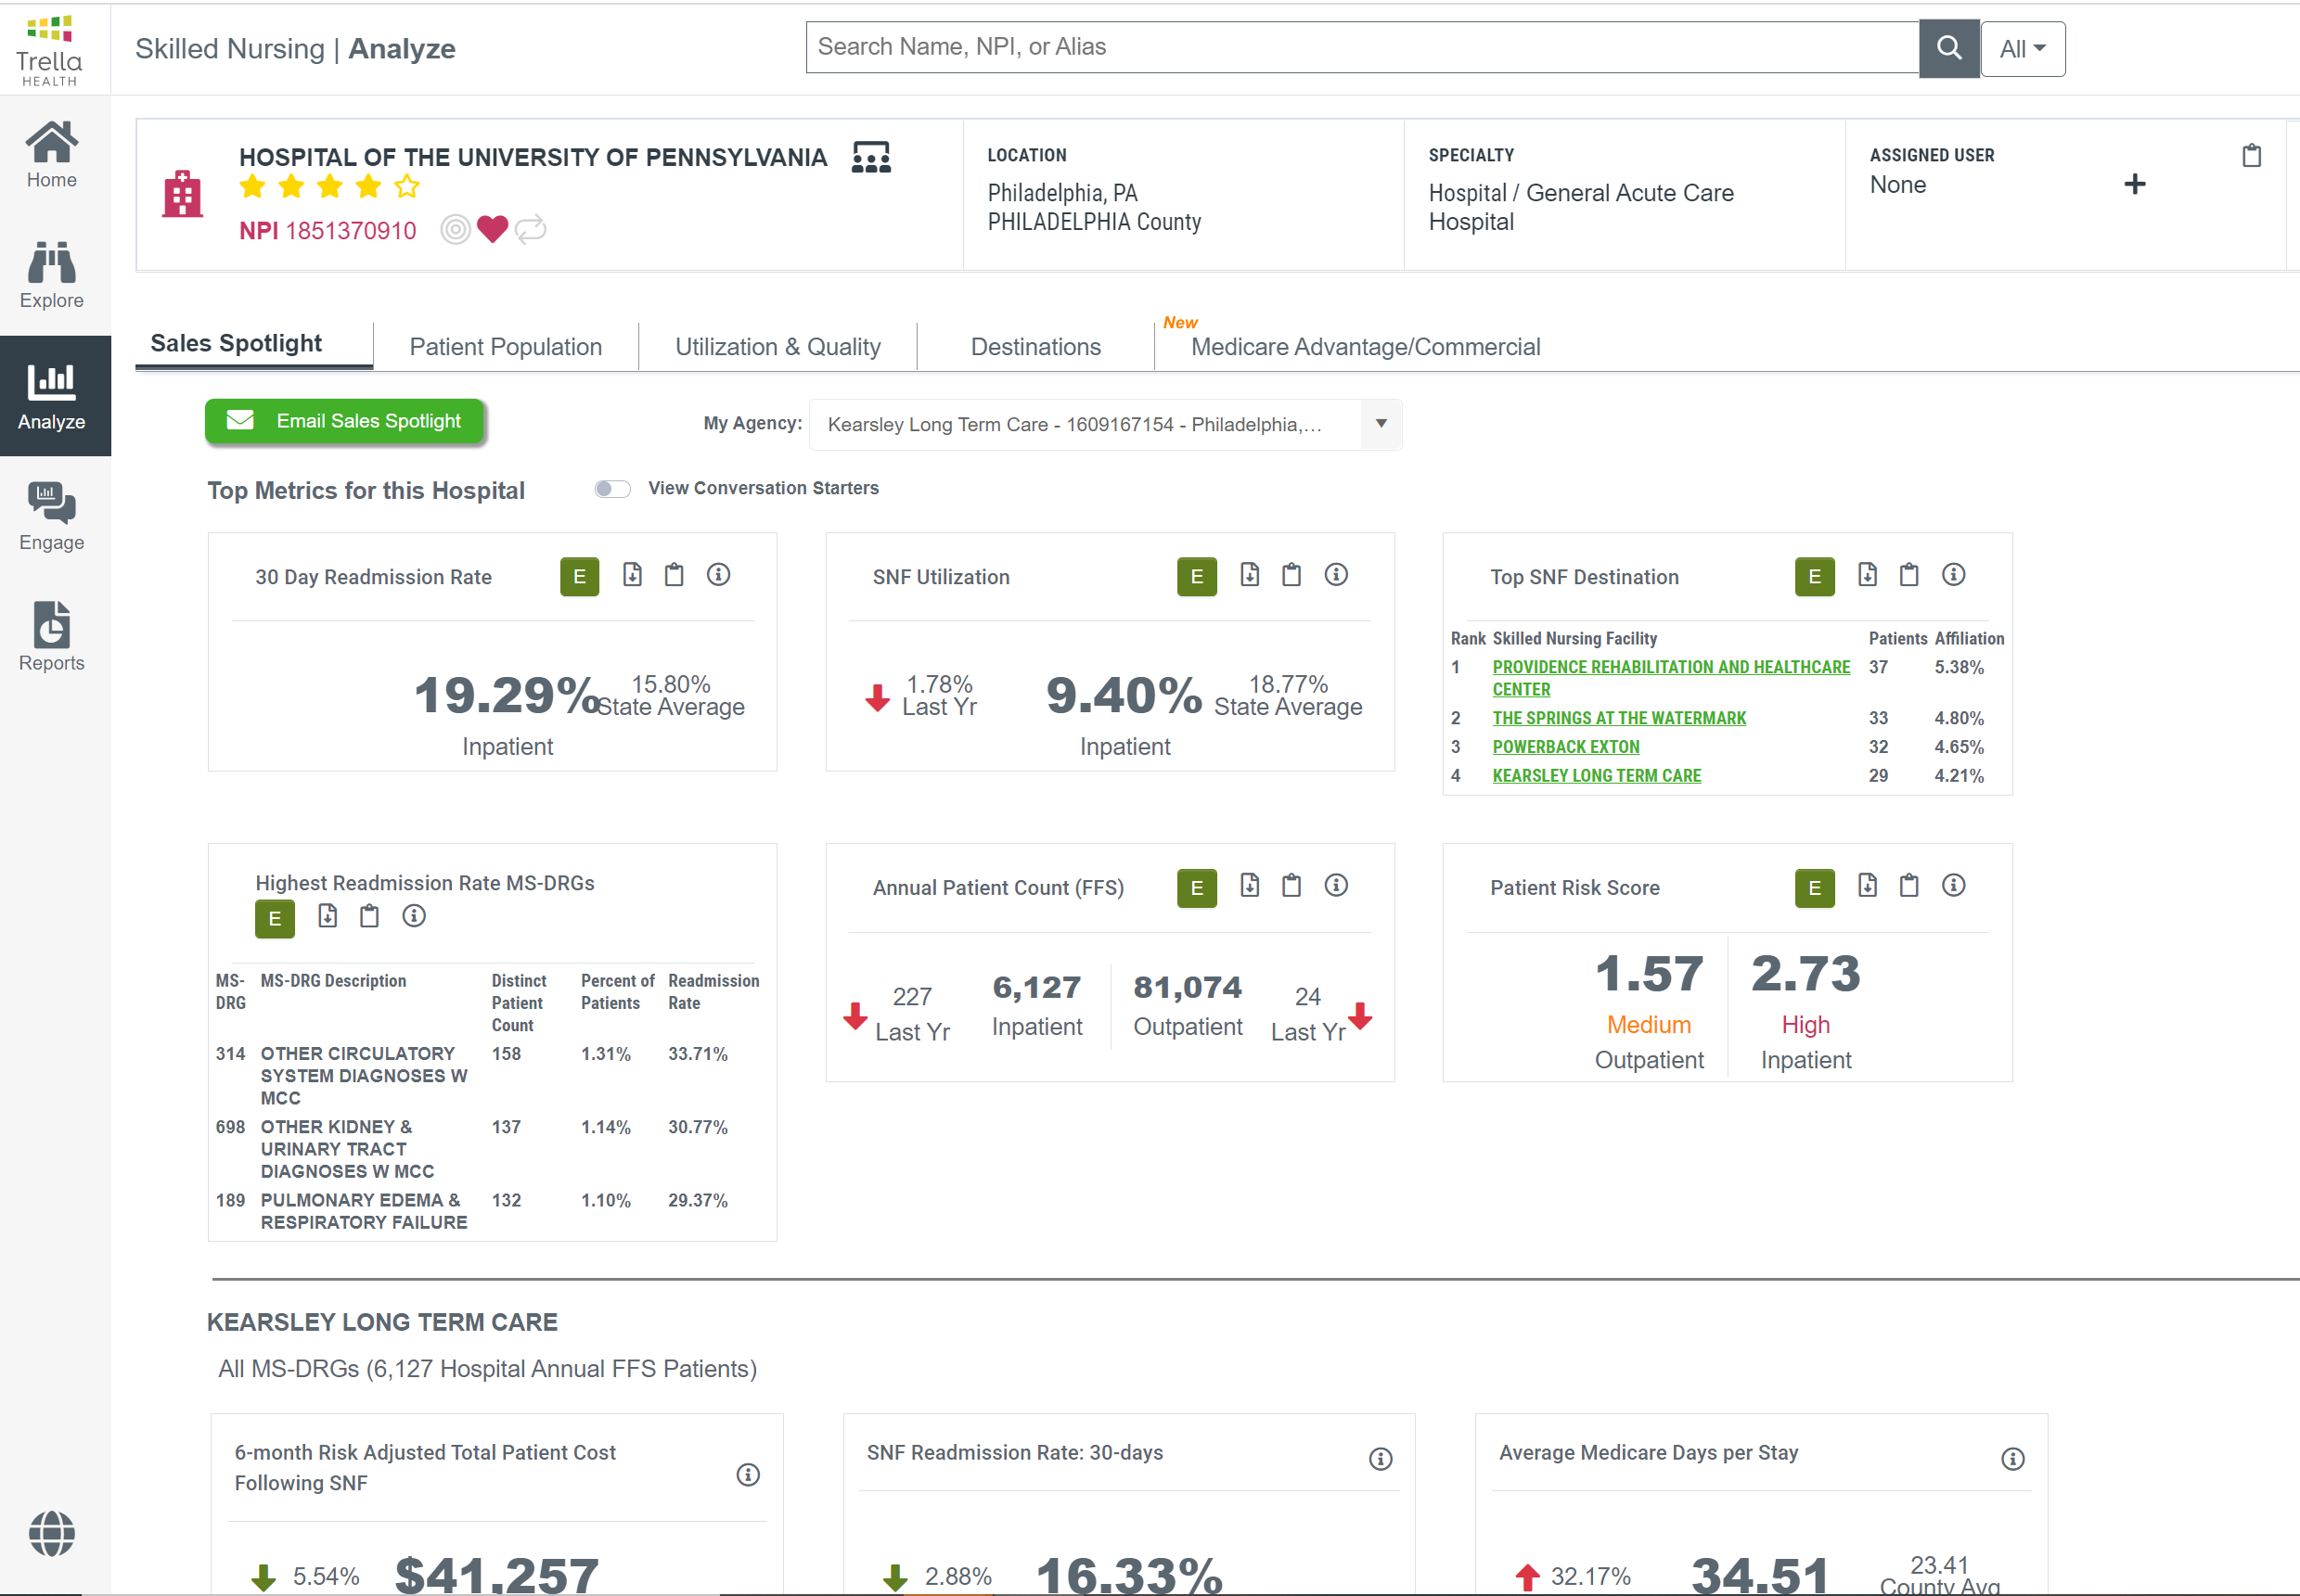
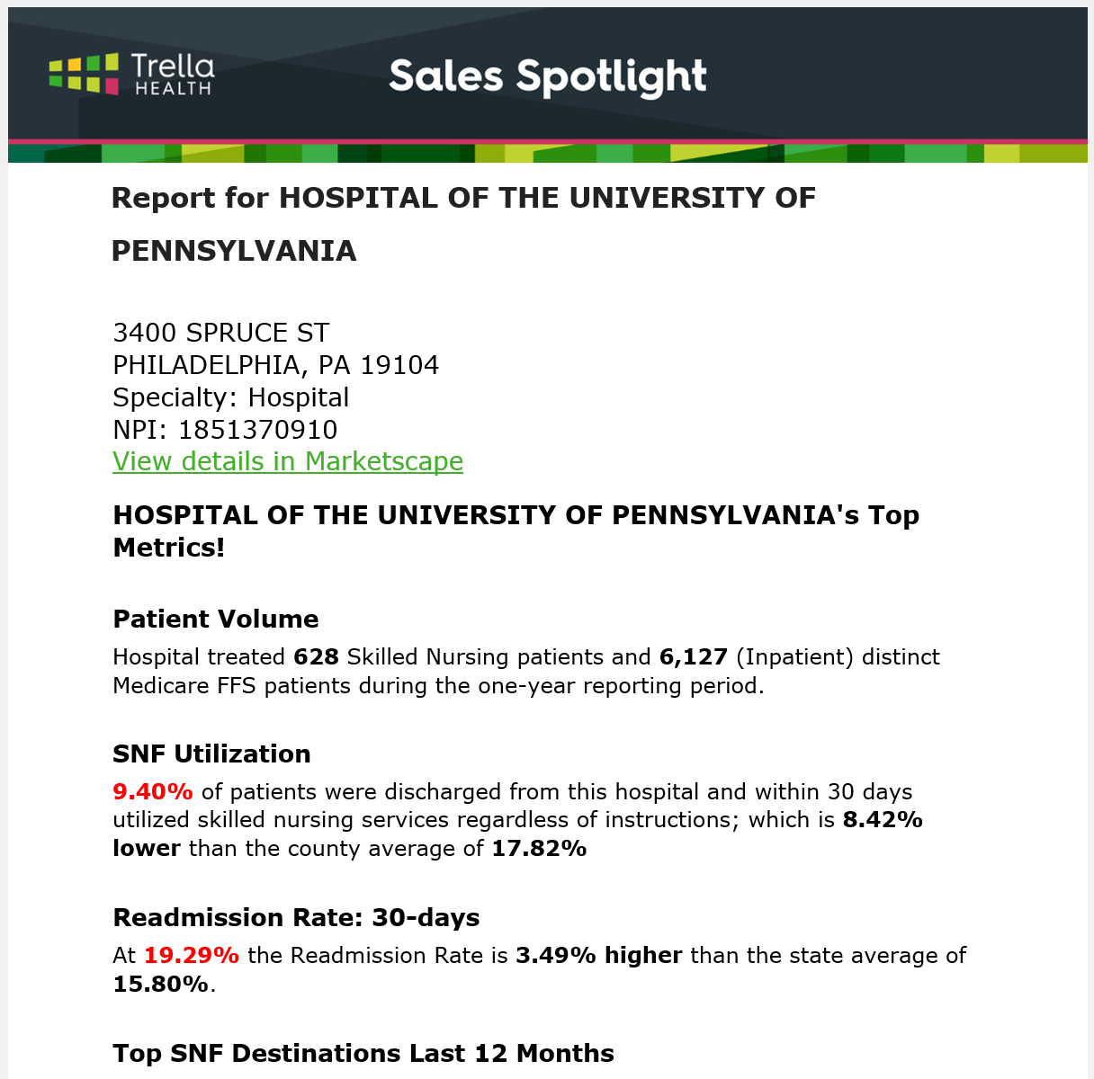
Hospital Sales Spotlight

Slide 18
PDPM Poll Question

Slide 19
Office Hours
A regularly scheduled time when Marketscape users can ask questions and receive expert guidance from our team of knowledgeable Customer Success Managers. Customer Success Managers will be available on an open zoom line every week on Tuesdays and Thursdays from 3:30-4pm Eastern.
Popular questions/topics include:
How do I find high potential physicians to target?
How do I understand my hospitals discharge patterns?
How to have a data driven conversation using Trella metrics?
Register Here!
Who: We welcome all users to join us on Office Hours. Sales reps may benefit most!
What: An open Zoom call where users can call in and ask questions live or ask for a guided walkthrough that our team can demo on the spot.
When: Tuesdays and Thursdays at 3:30-4pm Eastern.
Where: Register here! Remember, you can hop on to ask your question and hop off as office hours are come and go as you please.

