Slide 2
Marketscape: New metrics: MA, DRG, and ACO data
Wednesday, November 18th, 2020

Slide 3
Welcome
Today’s Presenter
Lauren Byers
Senior Consultant
Trainer, Moderator

Slide 4
Agenda:
During this 60-minute training session, we’ll show how your agency can use the new Medicare Advantage (MA) data within Marketscape.
Attendees will learn about:
• Quarterly enrollment trends for FFS and MA patients in the Market Share report
• The breakdown of MA plans and patient volumes for a specific NPI on Analyze pages
• Key metrics by Diagnosis-Related Group (DRG) for inpatient hospital stays
• Physicians participating in a Medicare Accountable Care Organization (ACO)

Slide 5
Key highlights: Medicare Advantage
Trella is excited to now offer the most recent Medicare Advantage data available from CMS in Marketscape.
On the market share report, where you can view quarterly enrollment figures for FFS and MA patients at the state or county level, the MA data is as recent as our FFS metrics, currently through Q1 2020.
On Analyze pages, where you can view the breakdown of MA plans and volumes for a given physician, home health agency, hospital, or skilled nursing NPI, the MA data is as recent as 2017.
While our inaugural Medicare Advantage release focused on providing the most recent MA data available from CMS (some of which is through 2017), we’ll be incorporating more recent data shortly. We will keep you posted on the release timing as we learn more.

Slide 6
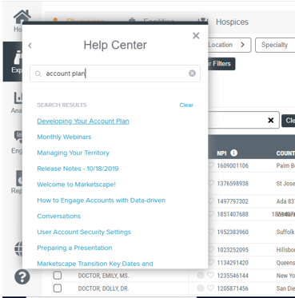
Questions?

